Slide 1
Title: Big Data Analytics in Smart Grids
(Optimizing Energy Generation, Distribution, and Consumption.)
RICHARD KUSEAMO JAMPANA (2425500031)
PHILIP SEYRAM QUACCU (1706212588)
FELIX LIIMAN TUATIR (2425500032)

Slide 2
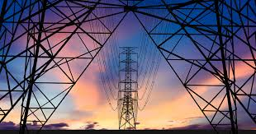
INTRODUCTION
Energy grid optimization is the process of enhancing the efficiency, reliability, and sustainability of electricity generation, distribution, and consumption. This involves using advanced technologies, data analytics, and innovative strategies to balance supply and demand, reduce energy losses, integrate renewable energy sources, and improve overall grid performance. The goal is to ensure a stable, cost-effective, and environmentally friendly energy system.

Slide 3
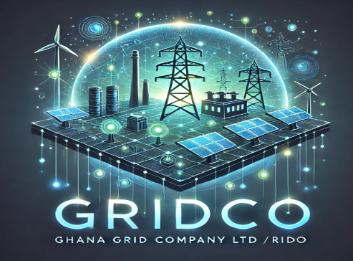
Optimizing Energy Generation
Predictive Maintenance
Renewable Energy Forecasting:
Efficient Resource Allocation:

Slide 4
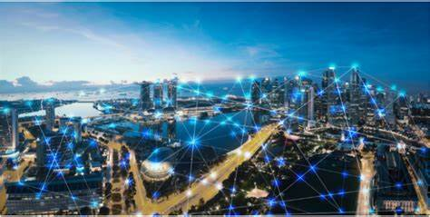
Optimizing Energy Distribution:
Grid Monitoring and Management: Real-time data from sensors and smart devices across the grid helps operators detect and respond to issues like outages, voltage fluctuations, or equipment failures.
Loss Reduction: Analytics can identify areas of high energy loss in the distribution network, enabling targeted improvements.
Dynamic Load Balancing: By analyzing consumption patterns, grid operators can redistribute loads to prevent overloading and improve grid stability.

Slide 5
Optimizing Energy Consumption
Demand Response Programs: Big data analytics enables utilities to predict peak demand periods and incentivize consumers to reduce usage during these times, flattening demand curves and avoiding grid stress.
Smart Meter Data Analysis: Data from smart meters provides insights into consumer behavior, enabling personalized energy-saving recommendations and dynamic pricing models.
Energy Efficiency Insights: Analytics can identify inefficiencies in buildings or industrial processes, helping consumers reduce energy consumption and costs.

Slide 6
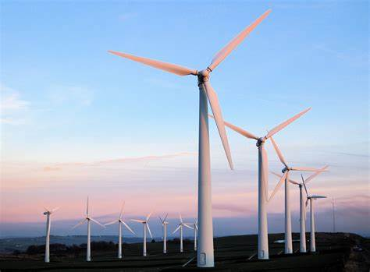
SIGNIFICANCE OF ENERGY GRID OPTIMIZATION
Integration of Renewable Energy: Balances the intermittency of solar and wind power using real-time data and forecasting, ensuring a stable and reliable energy supply.
2. Sustainability and Climate Change: Maximizes renewable energy use and minimizes losses, reducing carbon emissions and promoting a sustainable energy system.
3. Economic Benefits: Lowers operational costs and defers expensive infrastructure upgrades, saving money for utilities and consumers.
4. Energy Security and Reliability: Enhances grid resilience and diversifies energy sources, ensuring a stable and secure energy supply.
5. Consumer Empowerment: Provides real-time usage data and demand response programs, helping consumers save costs and manage energy efficiently.

Slide 7
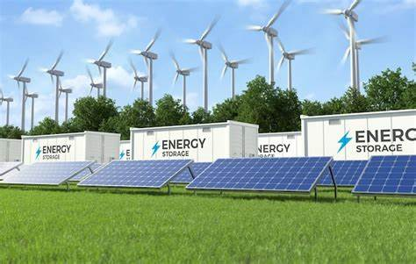
SMART GRIDS
Smart grids are advanced energy networks that use digital technology, real-time data, and automation to improve the efficiency, reliability, and sustainability of electricity generation, distribution, and consumption. Unlike traditional energy grids, which operate on a one-way flow of electricity from centralized power plants to consumers, smart grids enable two-way communication and energy flow. This allows for better integration of renewable energy sources, real-time monitoring, and dynamic management of supply and demand.
Key Differences from Traditional Grids
Two-Way Communication
Renewable Integration
Automation and Self-Healing
Enhanced Efficiency:

Slide 8
Challenges And Opportunities
Aging Infrastructure
Cybersecurity Risks:
Integration of Renewable Energy
Data Volume and Complexity

Slide 9
Key Technologies, Tools, and Methodologies
Big Data Analytics: Processes and analyzes grid data to optimize energy flow, improving efficiency and enabling better integration of renewables.
IoT Sensors: Collects real-time grid data, enhancing visibility and enabling faster fault detection and response.
Machine Learning and AI: Predicts demand and optimizes operations, improving grid stability and reducing energy waste.
Cloud Computing: Provides scalable data storage and processing, supporting real-time analytics and advanced grid applications.
Energy Management Systems (EMS): Monitors and controls grid operations, ensuring reliability and efficient energy distribution.

Slide 10
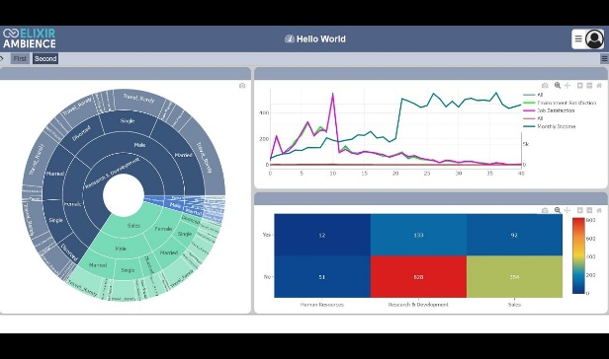
Case Study :Germany’s Energy Transition (Energiewende)
Germany has transitioned to renewable energy, with wind and solar now contributing over 40% of its electricity. Big data analytics is used to forecast renewable energy generation, balance
Impact:
Reduced carbon emissions by 40% since 1990.
Improved grid reliability despite the variability of renewables.
Enabled real-time adjustments to prevent blackouts and optimize energy flow.

Slide 11
Case Study 2: Duke Energy’s Grid Modernization
Duke Energy, a U.S.-based utility, integrated big data analytics and IoT sensors to monitor grid performance, predict demand, and optimize energy distribution.
Impact:
Reduced operational costs by 20% through predictive maintenance.
Improved outage response times by 30%, enhancing grid reliability.
Lowered carbon emissions by integrating more renewable energy sources.

Slide 12
Case Study 3: Enel’s Smart Grid Solutions
Implementation: Enel, an Italian utility, deployed smart meters, IoT sensors, and AI-driven analytics to optimize grid operations and integrate renewables.
Impact:
Reduced energy losses by 15% through better grid management.
Enabled 40 million smart meters, improving consumer energy efficiency.
Achieved a 30% reduction in CO₂ emissions since 2007.

Slide 13
Future Trends and Advancements
Decentralized Energy Systems: The rise of microgrids and localized energy generation.
Blockchain for Energy Trading: Blockchain technology could enable peer-to-peer energy trading.
Advanced Predictive Analytics: The use of AI to predict grid failures and optimize maintenance.
5G and Edge Computing: How faster communication networks and edge computing could enhance grid responsiveness.

